Slide 1



Data Science
Mega Trend of 21st Century
Sonia Sharma
Software Engineer-II

Slide 2
Agenda
Why To Learn Data Science
Evolution of Data and Statistics
What is Data Science
Purpose and Implementation of Data Science
Tools and Skills Required
Categories and Types of ML Models
Consequences

Slide 3

Why To Learn Data Science
Glassdoor has ranked Data Science as its topmost profession.
A fuel of 21st Century
Problem of Demand & Supply
A Lucrative Career

Slide 4

Evolution of Data and Statistics
Data is raw, unorganized facts that need to be processed. Data can be something simple and seemingly random and useless until it is organized.
Data are individual pieces of information, recorded and used for the purpose of analysis. It is the raw information from which statistics are created.
Statistics is the discipline that concerns the collection, organization, analysis, interpretation and presentation of data - its interpretation and presentation.

Slide 5
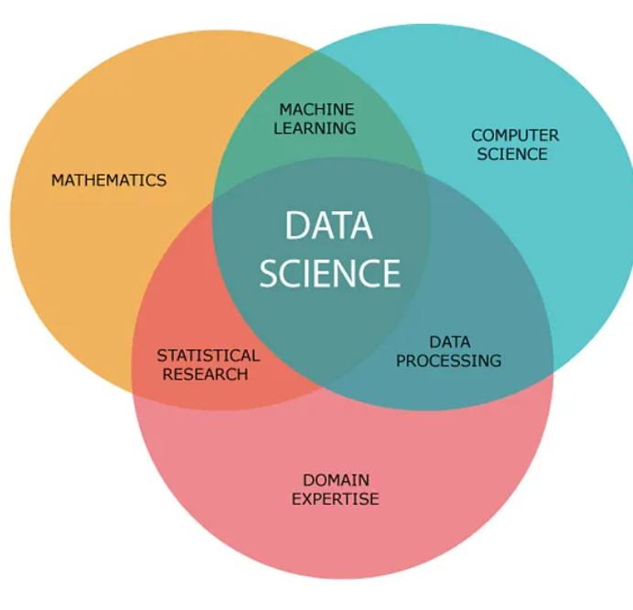
What is Data Science
Statistical and ML tools to draw Patterns and Make business Decisions.

Slide 6
Purpose of Data Science
Better Marketing
Customer Acquisition
Innovation
Enriching Lives

Slide 7
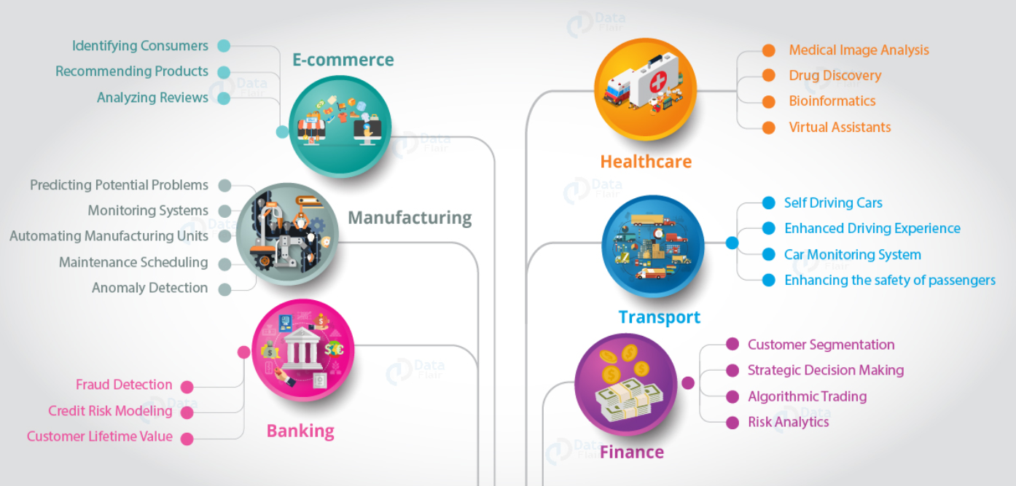
Implementations of Data Science

Slide 8
Places of Data Science in Data Universe
Artificial Intelligence
Machine Learning
Deep Learning
Big Data
Predictive Analysis
Business Intelligence

Slide 9
Role of a Data Scientist
Get Data
Meaningful Structure
Analyze
Hypothesize
Prediction (ML)

Slide 10
Top Skills for Data Science
Business Skills
Practical Skills (Math and Statistical)
Coding Skills
Soft Skills

Slide 11
Tools
Python / R
SQL
Hadoop
Excel/PowerBI/Tableau

Slide 12

Process To Target A Problem
Identify Data Sources
Ingest
Clean Data
Exploratory Data Analysis
Train/Test Split
Build Model on Train Data
Evaluate
Deploy, Monitor, Refine

Slide 13
Machine Learning Categories
Supervised Learning
Unsupervised Learning

Slide 14
Types Of Models
Regression
Classifications
Clustering

Slide 15
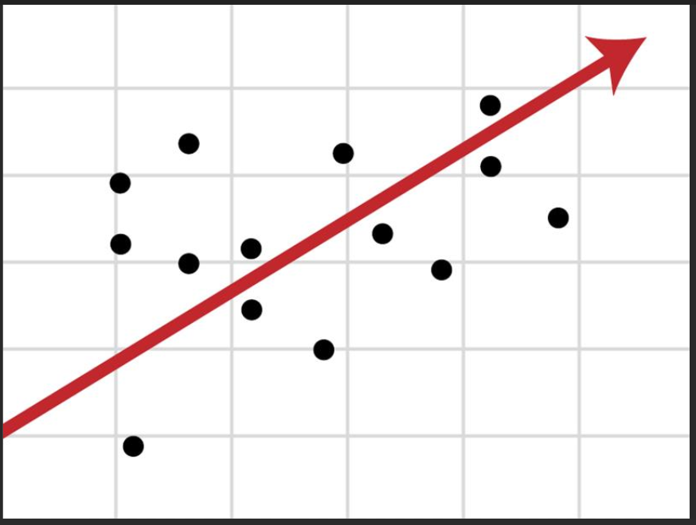
Types Of Regression Algorithms
Simple Linear Regression
Multiple Linear Regression
Lasso Regression
Support Vector Machine
Multiple Variate Regression

Slide 16

Types of Classification Algorithms
Logistic Regression
Naïve Bayes Algorithms
K-Nearest Neighbors
Decision Trees
Random Forest
Support Vector Algorithms

Slide 17
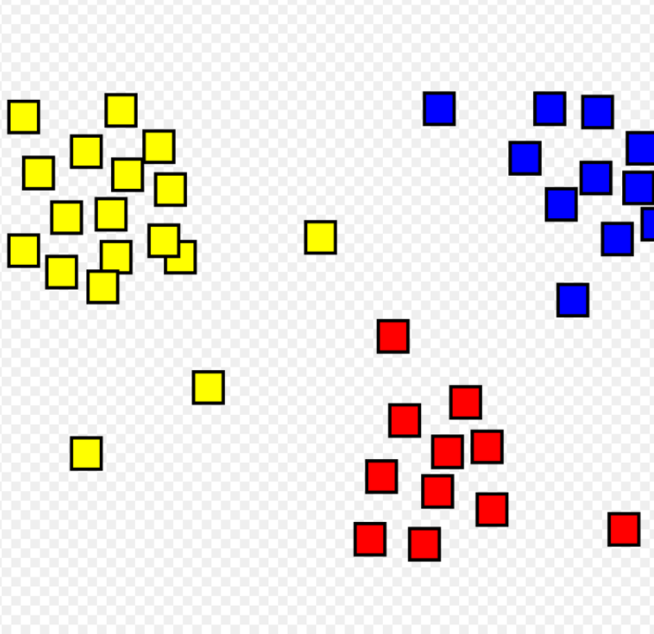
Types of Clustering Algorithms
K-Means Clustering
Mean Shift Clustering

Slide 18
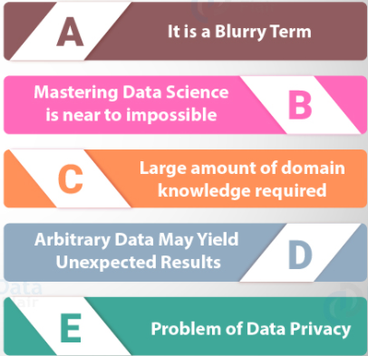
Consequences

Slide 19
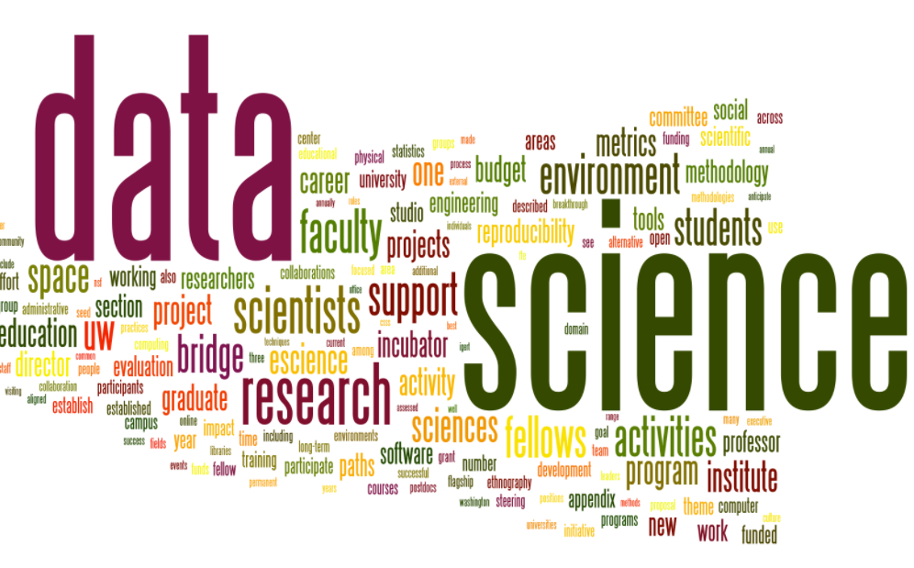
Summary
“While Data Science is a vast subject, It is a very robust field that best fits people who have a knack for experimentation and problem-solving. With a large number of applications, Data Science has become the most versatile career.”

Slide 20
References
Kaggle
Analytics Vidya
Linkedin Learning
Open Source Data Science Masters
Elite Data Science (65 Free Data Science Tutorials for Beginners)

Slide 21


Thank You
LinkedIn : www.linkedin.com/in/sonia~sharma Email: soniasharma7381@gmail.com

